Slide 1
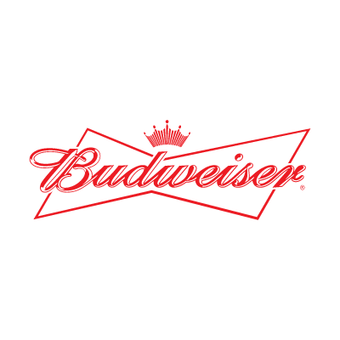

Exploratory Analysis of Brewery and Beer Data Sets
Customer: Budweiser
Presenters: Adam Alidra and Cameron Stewart

Slide 2
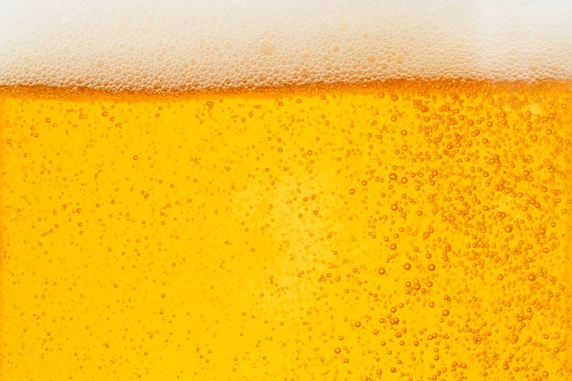

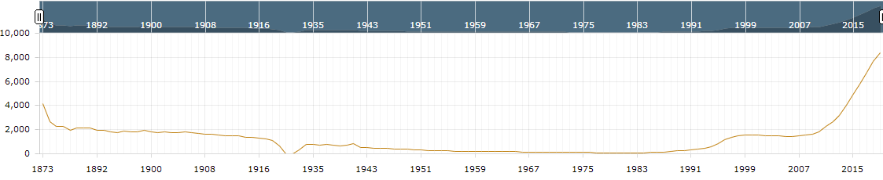
Executive Summary
Macro Findings of US Breweries and Beers Data Sets:
The Breweries listed are all US Breweries and all Beers listed are Craft Beers
The data references 51 states (Washington D.C. included as a ‘state’)
US Brewery and Craft Beer Market Public Data-at-a-Glance:
U.S. beer volume sales down 2% in 2019, while craft brewer sales continued to grow at rate of 4% by volume¹
Craft brewer sales reached 13.6% of the U.S. beer market by volume¹
Historical U.S. Brewery Count¹
¹https://www.brewersassociation.org/statistics-and-data/national-beer-stats/#:~:text=Summary,grew%20the%20most%20for%20taprooms.

Slide 3
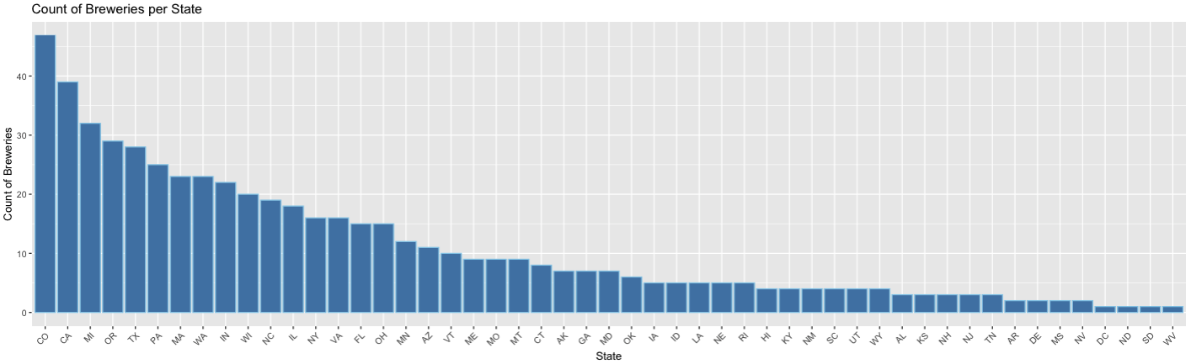
Breweries by the Numbers
Findings:
558 Total Breweries listed in the Breweries data set
Top 25% of states contain over 60% of the Breweries
CO and CA have the most Breweries in total

Slide 4
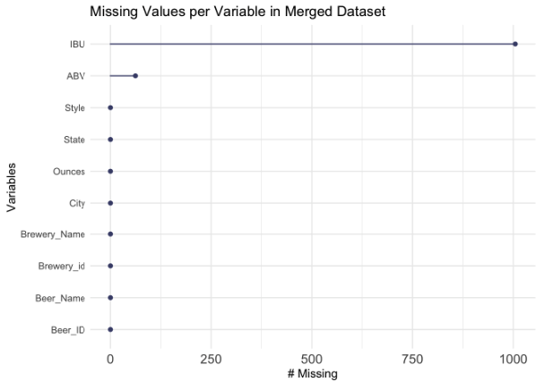
Analyzing Missing Values
Findings:
No NA values in Breweries data set
Merged data sets produce a combined 1067 NA values (all of which are found in the Beer data set)
1005 NA values are from the IBU column
62 NA values are from the ABV column

Slide 5
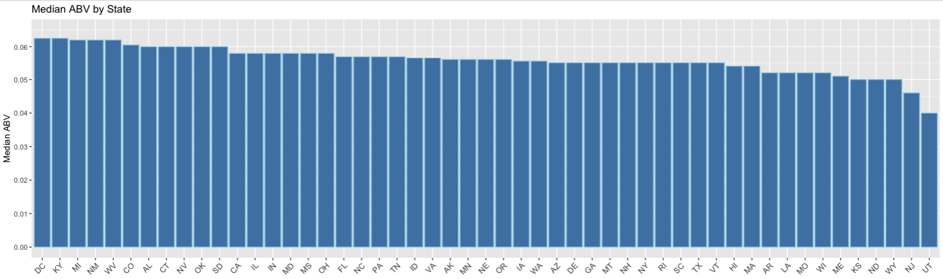
Median ABV by State
Findings:
DC and KY are tied for the highest ABV at 6.25%
UT has the lowest median ABV by a significant margin at 4.00%
84% of states have a median ABV between 5% - 6% (inclusive)

Slide 6
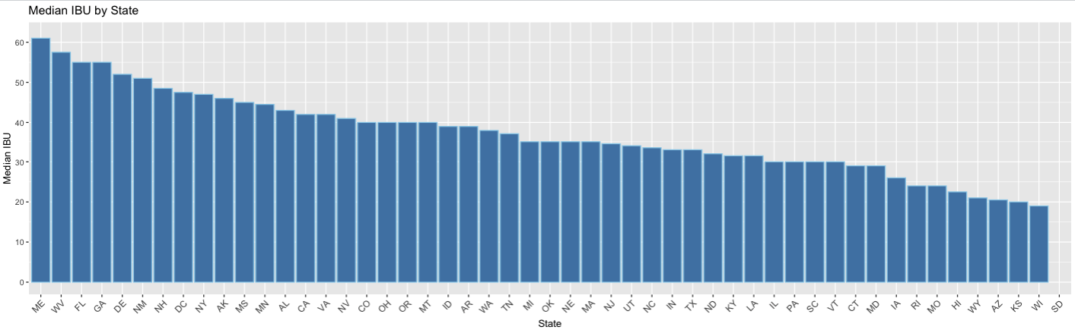
Median IBU by State
Findings:
ME has the highest median IBU
WI has the lowest median IBU
SD has no IBU data in the provided data sets (shown without bar below)

Slide 7
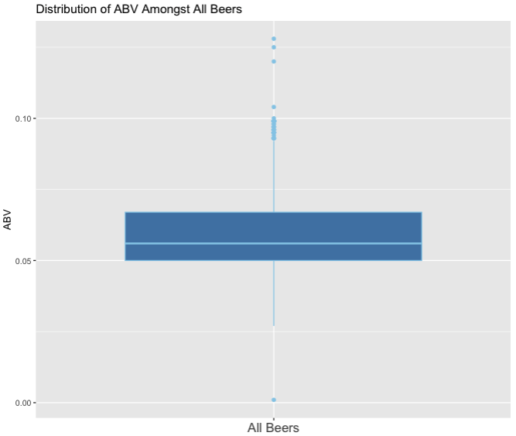
Maximum Values and ABV Distribution
Maximum Values:
Oregon’s Bitter Bitch Imperial IPA has the highest IBU of 138
Colorado’s Lee Hill Series Vol. 5- Belgian Style Quadrupel Ale has the highest ABV at 12.8%
ABV Distribution Findings:
The box plot is slightly right skewed which signifies higher dispersion in ABV in Q3 and Q4
Median ABV amongst all analyzed beers is 5.6%
There are significantly more outliers at the higher end of ABV than the lower end
Small subset of ABV outliers in top quartile hovering at or just below 10% ABV

Slide 8
Part 2

Slide 9
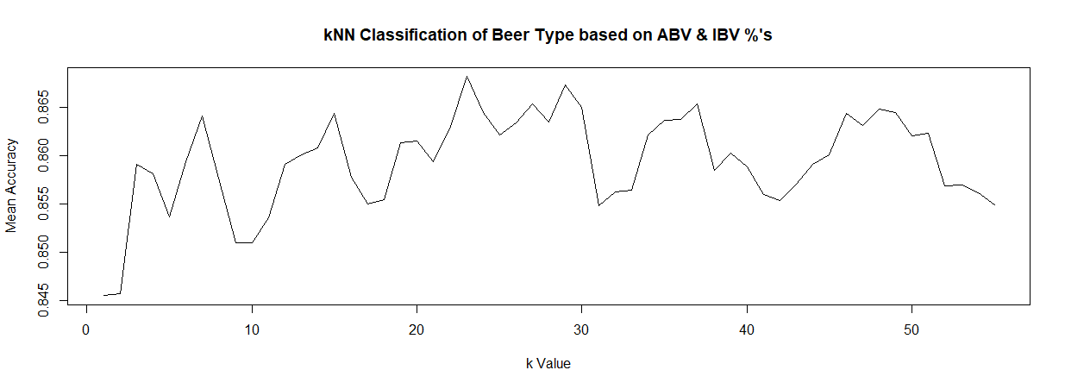
k-NN Classification of Beer Types by ABV & IBU %’s
Sample size of 15 beers tested over 55 separate training and test iterations
Only IPA and Other Ale Style beers sampled
Result: Mean Accuracy of 86.81% (or 820) discrete beer styles classified correctly based on provided ABV & IBV %’s
IPA’s were correctly identified (sensitivity) 84.18% of the time, while Other Ales were correctly classified 86.41%
Based on total data set of 944 beers

Slide 10
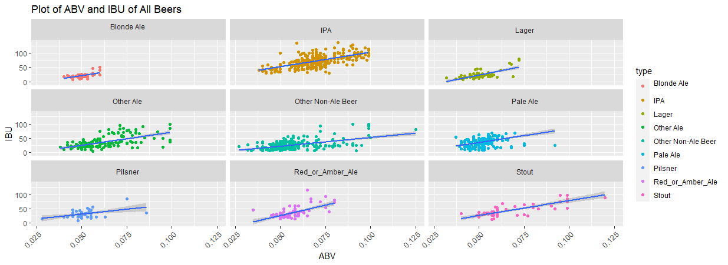
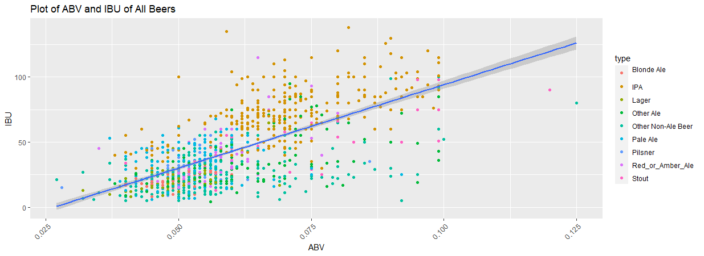
Categorization of All Beers- Contrasting Visual Representations
Notes:
Blond Ales are consistently on the lower end of ABV with a few outliers stretching into higher ABV content
Pale Ale’s, Pilsner, and Lager’s also, by and large, appear to be on the lower end of ABV & IBU %’s with the exception of a few outliers, either extending to higher ABV, IBU, or both
Stouts on the other hand are the most sporadic in terms of expected ABV% albeit they appear to represent the smallest sample size of beers amongst types

Slide 11
NaiveBayes Analysis of Beer Types by ABV & IBU %’s
Model 1: 20 Iterations
1403 beers evaluated across 10 categories
1 ‘catch-all’ category: “Other Non-Ale Beers”
70%/30% Training/Test Split
Mean Accuracy of 44.58% discrete beer styles classified correctly based on provided ABV & IBV %’s
The likelihood a beer type classification did not align to the probable ABV and IBV %’s was accurately identified (specificity) 86.53% of the time
Model 2: 50 Iterations
1403 beers evaluated across 10 categories
1 ‘catch-all’ category: “Other Non-Ale Beers”
70%/30% Training/Test Split
Mean Accuracy of 44.99% discrete beer styles classified correctly based on provided ABV & IBV %’s
The likelihood a beer type classification did not align to the probable ABV and IBV %’s was accurately identified (specificity) 86.47% of the time

Slide 12
kNN and NaïveBayes Comparative Considerations
Data sets between models varied by 32.7% in total number of objects (values)
Inclusion of a wider range of Beer Types and classifications (by an additional 8 categories)
A-priori probabilities of Blond Ale, Pilsner, Red or Amber Ales, and Stouts, in the Naïve Bayes model, signal
In respect to Naïve Bayes modeling, more iterations, as expected improved accuracy of proper classification of Beer Style respective to ABV and IBV values

Slide 13
Appendix

Slide 14
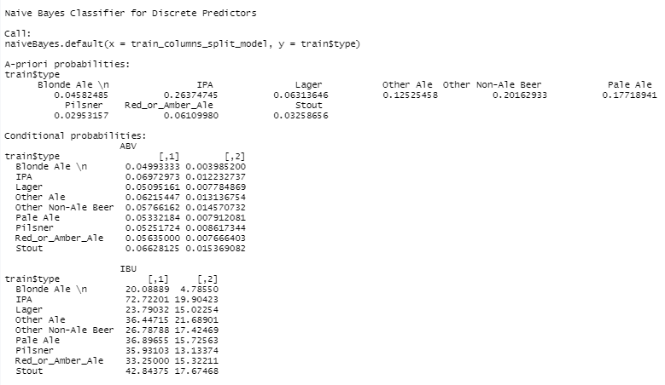
Naive Bayes Classifier for Discrete Predictors (iterations= 20)
Mean Accuracy:
.44.58%
Mean Sensitivity:
58.04%
Mean Specificity:
86.53%

Slide 15
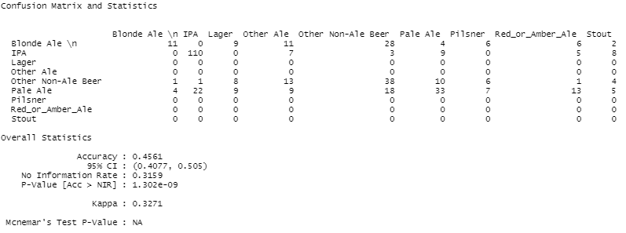
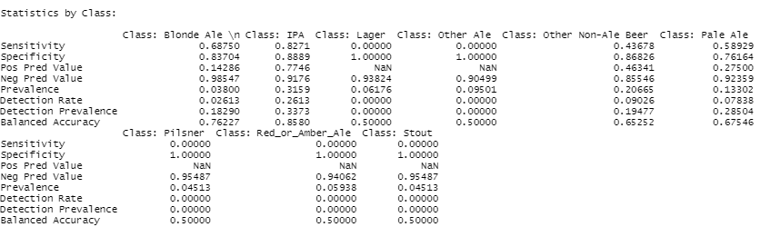
Naive Bayes Classifier for Discrete Predictors (iterations= 20)

Slide 16
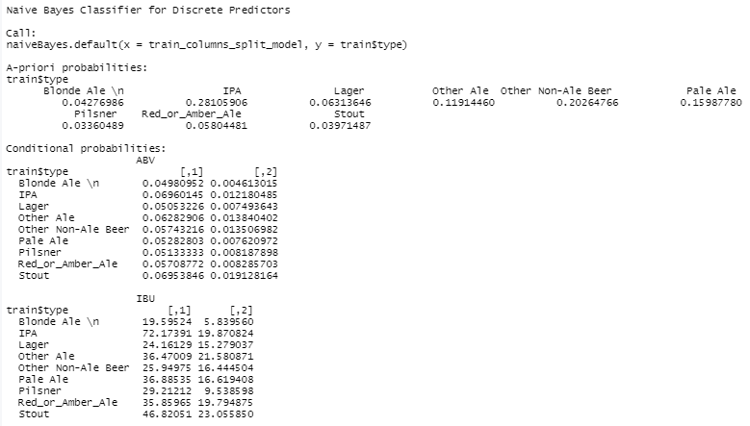
Naive Bayes Classifier for Discrete Predictors (iterations= 50)
Mean Accuracy:
.44.99%
Mean Sensitivity:
61.68%
Mean Specificity:
86.47%

Slide 17
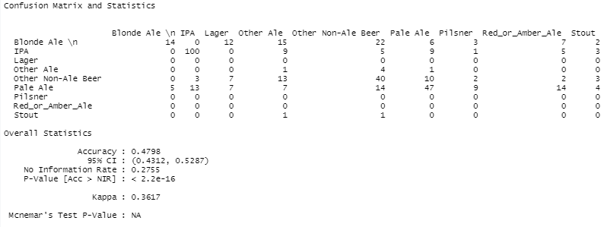
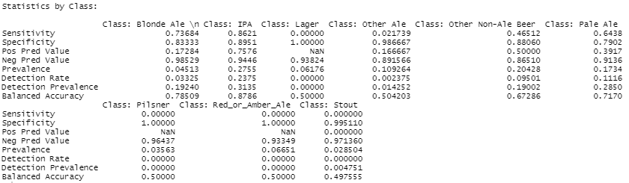
Naive Bayes Classifier for Discrete Predictors (iterations= 50)

Slide 18
THANK YOU!

